Slide 1
Chapter 11: Mass-Storage Systems大容量储存系统

Slide 2
Chapter 11: Mass-Storage Systems大容量储存系统
Overview of Mass Storage Structure
HDD Scheduling硬盘调度
NVM Scheduling非易失性存储器调度
Error Detection and Correction错误检测和纠正
Storage Device Management存储设备管理
Swap-Space Management交换空间管理
Storage Attachment存储附件
RAID Structure磁盘阵列结构

Slide 3
Objectives目标
Describe the physical structure of secondary storage devices and the effect of a device’s structure on its uses.描述二级存储设备的物理结构以及设备结构对其使用的影响
Explain the performance characteristics of mass-storage devices.解释大容量存储设备的性能特征
Evaluate I/O scheduling algorithms.评估 I/O 调度算法
Discuss operating-system services provided for mass storage, including RAID.讨论为大容量存储提供的操作系统服务，包括 RAID

Slide 4
Overview of Mass Storage Structure
Bulk of secondary storage for modern computers is hard disk drives (HDDs) and nonvolatile memory (NVM) devices.现代计算机的大量二级存储是硬盘驱动器 (HDD) 和非易失性存储器 (NVM) 设备。
HDDs spin platters of magnetically-coated material under moving read-write heads.硬盘驱动器在移动的读写磁头下旋转磁性涂层材料的盘片。
Drives rotate at 60 to 250 times per second.驱动器以每秒 60 到 250 次的速度旋转。
Transfer rate is rate at which data flow between drive and computer.传输速率是驱动器和计算机之间数据流的速率。
Positioning time (random-access time) is time to move disk arm to desired cylinder (seek time) and time for desired sector to rotate under the disk head (rotational latency).定位时间（随机访问时间）是将磁盘臂移动到所需柱面的时间（寻道时间）和所需扇区在磁头下方旋转的时间（旋转延迟）。
Head crash results from disk head making contact with the disk surface -- That’s bad.磁头碰撞是由磁头与磁盘表面接触造成的——这很糟糕。
Disks can be removable

Slide 5
Moving-head Disk Mechanism

Slide 6

Hard Disk Drives硬盘驱动器
Platters range from .85” to 14” (historically).盘片范围从 0.85 英寸到 14 英寸（历史上）
Commonly 3.5”, 2.5”, and 1.8”.通常为 3.5”、2.5” 和 1.8”
Range from 30GB to 3TB per drive
Performance
Transfer Rate – theoretical – 6 Gb/sec.传输速率 – 理论 – 6 Gb/秒
Effective Transfer Rate – real – 1Gb/sec.有效传输速率 – 实际 – 1Gb/秒
Seek time from 3ms to 12ms – 9ms common for desktop drives.寻道时间从 3 毫秒到 12 毫秒 - 台式机硬盘常见的 9 毫秒
Average seek time measured or calculated based on 1/3 of tracks.基于 1/3 的轨道测量或计算的平均寻道时间
Latency based on spindle speed.基于主轴速度的延迟
1 / (RPM / 60) = 60 / RPM
Average latency = ½ latency

Slide 7
Hard Disk Performance
Access Latency = Average access time = average seek time + average latency.访问延迟 = 平均访问时间 = 平均寻道时间 + 平均延迟
For fastest disk 3ms + 2ms = 5ms.对于最快的磁盘 3ms + 2ms = 5ms
For slow disk 9ms + 5.56ms = 14.56ms
Average I/O time = average access time + (amount to transfer / transfer rate) + controller overhead.平均 I/O 时间 = 平均访问时间 +（传输量/传输速率）+ 控制器开销。
For example to transfer a 4KB block on a 7200 RPM disk with a 5ms average seek time, 1Gb/sec transfer rate with a .1ms controller overhead =.例如，在 7200 RPM 磁盘上传输 4KB 块，平均寻道时间为 5ms，传输速率为 1Gb/秒，控制器开销为 0.1ms =
5ms + 4.17ms + 0.1ms + transfer time =
Transfer time = 4KB / 1Gb/s * 8Gb / GB * 1GB / 1024²KB = 32 / (1024²) = 0.031 ms
Average I/O time for 4KB block = 9.27ms + .031ms = 9.301ms

Slide 8
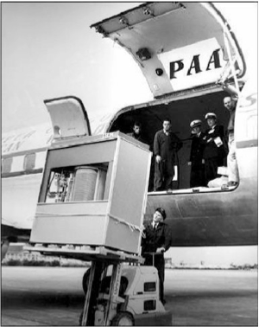
The First Commercial Disk Drive
1956
IBM RAMDAC computer included the IBM Model 350 disk storage system
5M (7 bit) characters
50 x 24” platters
Access time = < 1 second

Slide 9
Nonvolatile Memory Devices非易失性存储设备
If disk-drive like, then called solid-state disks (SSDs).如果是磁盘驱动器，则称为固态磁盘 (SSD)。
Other forms include USB drives (thumb drive, flash drive), DRAM disk replacements, surface-mounted on motherboards, and main storage in devices like smartphones.其他形式包括 USB 驱动器（拇指驱动器、闪存驱动器）、DRAM 磁盘更换、主板表面安装以及智能手机等设备中的主存储。
Can be more reliable than HDDs.可以比 HDD 更可靠。
More expensive per MB.比 HDD 更贵
Maybe have shorter life span – need careful management.可能寿命较短——需要谨慎管理
Less capacity.容量较小
But much faster.但是更快
Busses can be too slow -> connect directly to PCI for example.总线可能太慢 -> 例如直接连接到 PCI。
No moving parts, so no seek time or rotational latency.没有移动部件，因此没有寻道时间或旋转延迟。

Slide 10
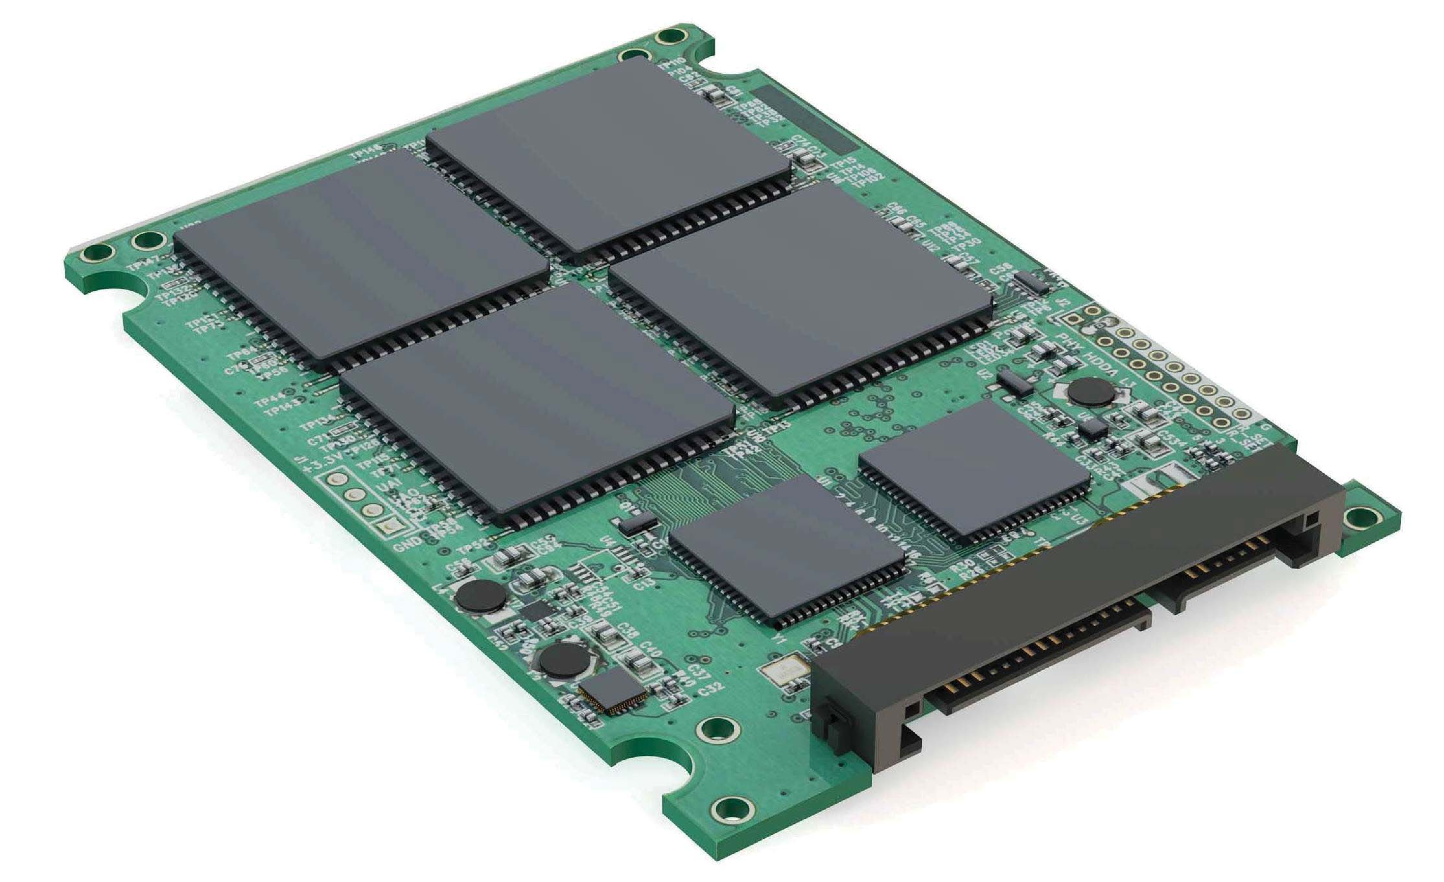
Nonvolatile Memory Devices非易失性存储设备
Have characteristics that present challenges.具有挑战的特征。
Read and written in “page” increments (think sector) but can’t overwrite in place.以“页”增量（想想扇区）读取和写入，但不能就地覆盖。
Must first be erased, and erases happen in larger ”block” increments.必须首先擦除，擦除发生在更大的“块”增量中。
Can only be erased a limited number of times before worn out – ~ 100,000.在磨损之前只能擦除有限的次数，大约100,000次。
Life span measured in drive writes per day (DWPD).以每天驱动器写入次数 (DWPD) 衡量的使用寿命。
A 1TB NAND drive with rating of 5DWPD is expected to have 5TB per day written within warrantee period without failing.额定值为 5DWPD 的 1TB NAND 驱动器预计在保修期内每天写入 5TB 且不会出现故障。

Slide 11
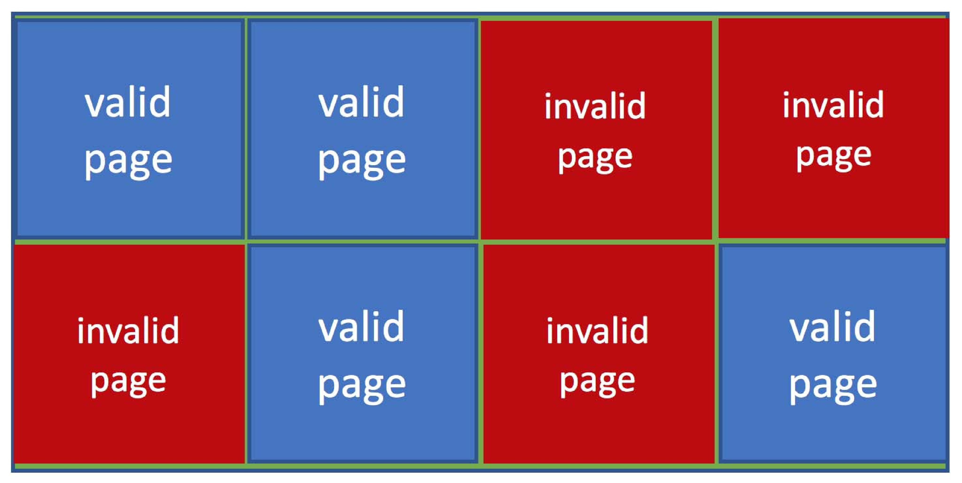
NAND Flash Controller Algorithms.NAND闪存控制器算法
With no overwrite, pages end up with mix of valid and invalid data.如果没有覆盖，页面最终会混合有效和无效数据。
To track which logical blocks are valid, controller maintains flash translation layer (FTL) table.为了跟踪哪些逻辑块有效，控制器维护闪存转换层 (FTL) 表。
Also implements garbage collection to free invalid page space.还实现垃圾收集以释放无效页面空间。
Allocates overprovisioning to provide working space for GC.分配超额配置为 GC 提供工作空间。
Each cell has lifespan, so wear leveling needed to write equally to all cells.每个单元都有使用寿命，因此需要均衡写入所有单元。
NAND block with valid and invalid pages

Slide 12
Volatile Memory易失性内存
DRAM frequently used as mass-storage device.DRAM 经常用作大容量存储设备。
Not technically secondary storage because volatile, but can have file systems, be used like very fast secondary storage.从技术上讲，不是辅助存储，因为它是易失的，但可以使用文件系统，就像使用非常快速的辅助存储一样。
RAM drives (with many names, including RAM disks) present as raw block devices, commonly file system formatted.RAM驱动器（具有许多名称，包括RAM磁盘）作为原始块设备显示，通常是文件系统格式。
Computers have buffering, caching via RAM, so why RAM drives?计算机具有缓冲、通过 RAM 缓存，那么为什么要使用 RAM 驱动器呢？
Caches / buffers allocated / managed by programmer, operating system, hardware.由程序员、操作系统、硬件分配/管理的缓存/缓冲区。
RAM drives under user control.RAM驱动器受用户控制。
Found in all major operating systems.在所有主要操作系统中都可以找到。
Linux /dev/ram, macOS diskutil to create them, Linux /tmp of file system type tmpfs.Linux /dev/ram，macOS diskutil创建它们，Linux /tmp 文件系统类型为 tmpfs。
Used as high speed temporary storage.用作高速临时存储。
Programs could share bulk date, quickly, by reading/writing to RAM drive.程序可以通过读取/写入 RAM 驱动器快速共享批量数据

Slide 13
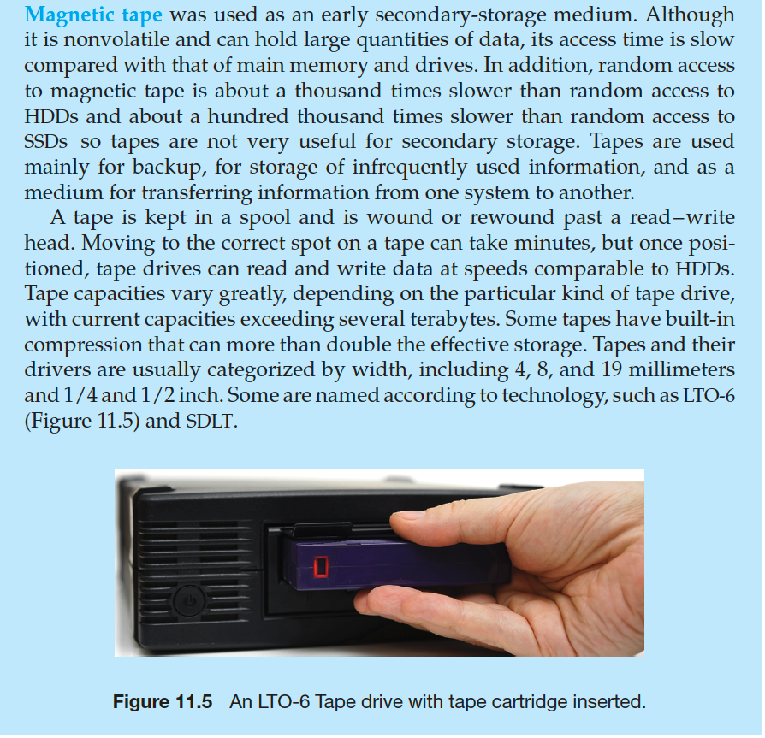
Magnetic Tape磁带

Slide 14
Disk Structure磁盘结构
Disk drives are addressed as large 1-dimensional arrays of logical blocks, where the logical block is the smallest unit of transfer.磁盘驱动器被寻址为大型一维逻辑块阵列，其中逻辑块是最小的传输单元。
Low-level formatting creates logical blocks on physical media.低级格式化在物理介质上创建逻辑块。
The 1-dimensional array of logical blocks is mapped into the sectors of the disk sequentially.逻辑块的一维数组按顺序映射到磁盘的扇区中。
Sector 0 is the first sector of the first track on the outermost cylinder.扇区 0 是最外柱面第一个磁道的第一个扇区。
Mapping proceeds in order through that track, then the rest of the tracks in that cylinder, and then through the rest of the cylinders from outermost to innermost.映射按顺序通过该磁道，然后是该柱面中的其余磁道，然后是从最外到最内的其余柱面。
Logical to physical address should be easy.逻辑到物理地址应该很容易
Except for bad sectors.坏道除外。
Non-constant # of sectors per track via constant angular velocity.通过恒定角速度，每个磁道的扇区数不固定。

Slide 15
Disk Attachment磁盘附件
Host-attached storage accessed through I/O ports talking to I/O busses.通过与 I/O 总线通信的 I/O 端口访问的主机附加存储。
Several busses available, including advanced technology attachment (ATA), serial ATA (SATA), eSATA, serial attached SCSI (SAS), universal serial bus (USB), and fibre channel (FC).多种可用总线，包括高级技术附件 (ATA)、串行 ATA (SATA)、eSATA、串行连接 SCSI (SAS)、通用串行总线 (USB) 和光纤通道 (FC)。
Most common is SATA.最常见的是SATA。
Because NVM much faster than HDD, new fast interface for NVM called NVM express (NVMe), connecting directly to PCI bus.由于 NVM 比 HDD 快得多，新的 NVM 快速接口称为 NVM express (NVMe)，直接连接到 PCI 总线。
Data transfers on a bus carried out by special electronic processors called controllers (or host-bus adapters, HBAs).总线上的数据传输由称为控制器（或主机总线适配器，HBA）的特殊电子处理器执行。
Host controller on the computer end of the bus, device controller on device end.总线计算机端的主机控制器，设备端的设备控制器。
Computer places command on host controller, using memory-mapped I/O ports.计算机使用内存映射 I/O 端口将命令放置在主机控制器上。
Host controller sends messages to device controller.主机控制器向设备控制器发送消息。
Data transferred via DMA between device and computer DRAM.数据通过 DMA 在设备和计算机 DRAM 之间传输。

Slide 16
Address Mapping地址映射
Disk drives are addressed as large 1-dimensional arrays of logical blocks, where the logical block is the smallest unit of transfer.磁盘驱动器被寻址为大型一维逻辑块阵列，其中逻辑块是最小的传输单元。
Low-level formatting creates logical blocks on physical media.低级格式化在物理介质上创建逻辑块。
The 1-dimensional array of logical blocks is mapped into the sectors of the disk sequentially.逻辑块的一维数组按顺序映射到磁盘的扇区中。
Sector 0 is the first sector of the first track on the outermost cylinder.扇区0是最外柱面第一个磁道的第一个扇区。
Mapping proceeds in order through that track, then the rest of the tracks in that cylinder, and then through the rest of the cylinders from outermost to innermost.映射按顺序通过该磁道，然后是该柱面中的其余磁道，然后是从最外到最内的其余柱面。
Logical to physical address should be easy.逻辑到物理地址应该很容易。
Except for bad sectors.坏道除外。
Non-constant # of sectors per track via constant angular velocity.通过恒定角速度，每个磁道的扇区数不固定。

Slide 17
HDD Scheduling硬盘调度
The operating system is responsible for using hardware efficiently — for the disk drives, this means having a fast access time and disk bandwidth.操作系统负责有效地使用硬件——对于磁盘驱动器，这意味着具有快速的访问时间和磁盘带宽。
Minimize seek time.最小化寻道时间
Seek time ≈ seek distance.寻道时间 ≈ 寻道距离
Disk bandwidth is the total number of bytes transferred, divided by the total time between the first request for service and the completion of the last transfer.磁盘带宽是传输的总字节数除以第一次请求服务和完成最后一次传输之间的总时间。

Slide 18
Disk Scheduling (Cont.)磁盘调度（续）
There are many sources of disk I/O request.磁盘 I/O 请求的来源有很多。
OS
System processes
Users processes
I/O request includes input or output mode, disk address, memory address, number of sectors to transfer.I/O 请求包括输入或输出模式、磁盘地址、内存地址、要传输的扇区数
OS maintains queue of requests, per disk or device.操作系统维护每个磁盘或设备的请求队列。
Idle disk can immediately work on I/O request, busy disk means work must queue.空闲磁盘可以立即处理 I/O 请求，繁忙的磁盘意味着工作必须排队。
Optimization algorithms only make sense when a queue exists.优化算法仅在队列存在时才有意义。
In the past, operating system responsible for queue management, disk drive head scheduling.过去，操作系统负责队列管理、磁盘驱动器磁头调度。
Now, built into the storage devices, controllers.现在，内置于存储设备、控制器中。
Just provide LBAs, handle sorting of requests.只需提供 LBA，处理请求的排序。
Some of the algorithms they use described next.下面描述了他们使用的一些算法

Slide 19
Disk Scheduling (Cont.)
Note that drive controllers have small buffers and can manage a queue of I/O requests (of varying “depth”).请注意，驱动器控制器具有小缓冲区，可以管理 I/O 请求队列（不同“深度”）。
Several algorithms exist to schedule the servicing of disk I/O requests.存在多种算法来调度磁盘 I/O 请求的服务。
The analysis is true for one or many platters.该分析适用于一个或多个盘片。
We illustrate scheduling algorithms with a request queue (0-199).我们用请求队列 (0-199) 来说明调度算法。
98, 183, 37, 122, 14, 124, 65, 67
Head pointer 53.头部指针53

Slide 20
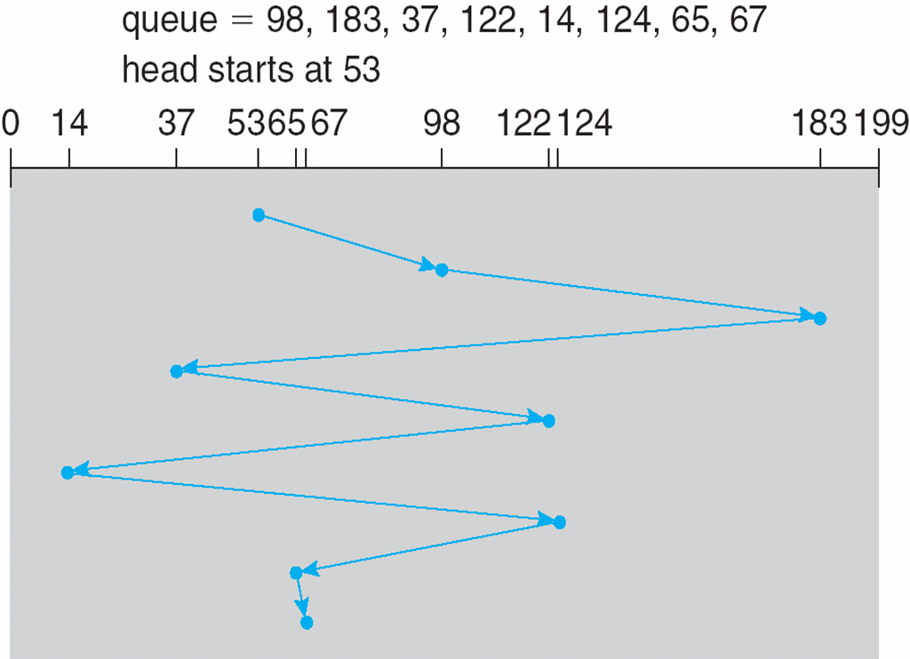
FCFS先到先服务
Illustration shows total head movement of 640 cylinders.
插图显示了 640 个气缸的总磁头移动

Slide 21
SCAN扫描
The disk arm starts at one end of the disk, and moves toward the other end, servicing requests until it gets to the other end of the disk, where the head movement is reversed and servicing continues.磁盘臂从磁盘的一端开始，然后向另一端移动，为请求提供服务，直到它到达磁盘的另一端，在那里磁头运动反向并继续提供服务。
SCAN algorithm Sometimes called the elevator algorithm.扫描算法有时也称为电梯算法。
Illustration shows total head movement of 208 cylinders.插图显示了208 个气缸的总磁头移动。
But note that if requests are uniformly dense, largest density at other end of disk and those wait the longest.但请注意，如果请求密度均匀，则磁盘另一端的密度最大，等待时间最长。

Slide 22
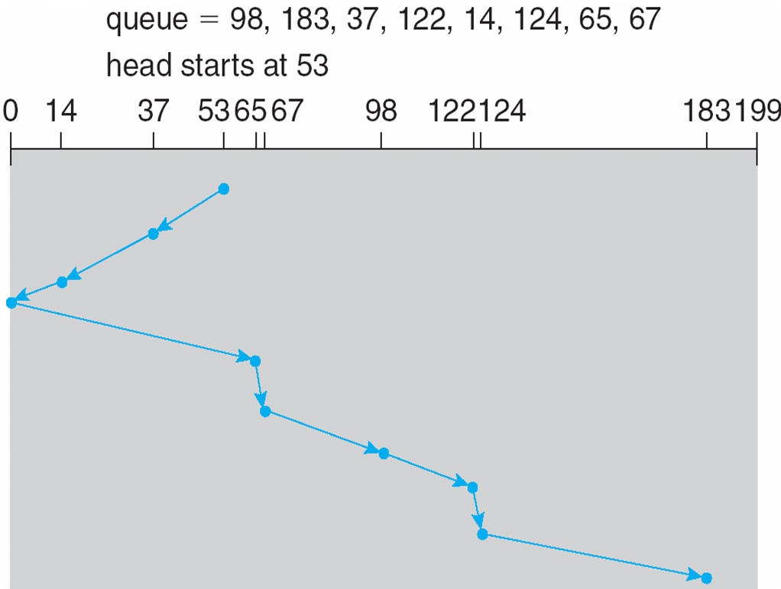
SCAN (Cont.)

Slide 23
C-SCAN
Provides a more uniform wait time than SCAN.提供比 SCAN 更统一的等待时间
The head moves from one end of the disk to the other, servicing requests as it goes.磁头从磁盘的一端移动到另一端，同时为请求提供服务。
When it reaches the other end, however, it immediately returns to the beginning of the disk, without servicing any requests on the return trip.但是，当它到达另一端时，它会立即返回到磁盘的开头，而不会在回程中为任何请求提供服务。
Treats the cylinders as a circular list that wraps around from the last cylinder to the first one.将圆柱体视为从最后一个圆柱体到第一个圆柱体环绕的圆形列表。
Total number of cylinders?气缸总数？

Slide 24
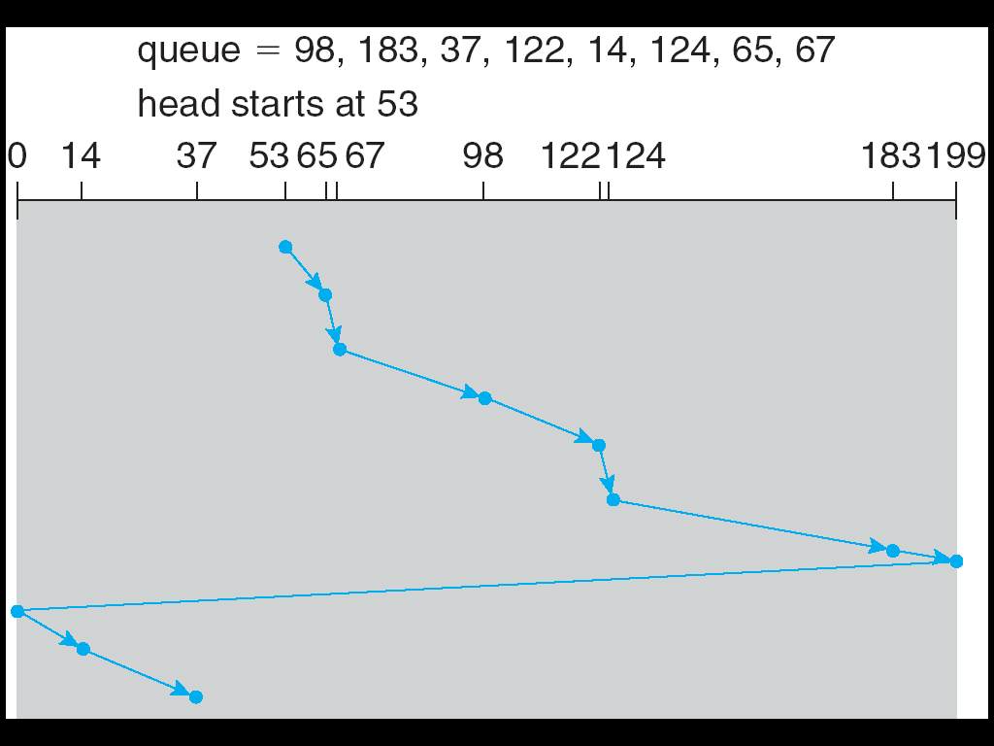
C-SCAN (Cont.)

Slide 25
Selecting a Disk-Scheduling Algorithm选择磁盘调度算法
SSTF is common and has a natural appeal.SSTF很常见并且具有天然的吸引力。
SCAN and C-SCAN perform better for systems that place a heavy load on the disk.SCAN和C-SCAN对磁盘负载较重的系统表现更好。
Less starvation, but still possible.减少饥饿，但仍有可能。
To avoid starvation Linux implements deadline scheduler.为了避免饥饿，Linux实现了截止日期调度程序。
Maintains separate read and write queues, gives read priority.保持独立的读写队列，给予读优先权。
Because processes more likely to block on read than write.因为进程更可能阻塞读而不是写
Implements four queues: 2 x read and 2 x write.实现四个队列：2 x 读取和 2 x 写入。
1 read and 1 write queue sorted in LBA order, essentially implementing C-SCAN.1 个读和1个写队列按 LBA 顺序排序，本质上实现了 C-SCAN。
1 read and 1 write queue sorted in FCFS order.按 FCFS 顺序排序的 1 个读取和 1 个写入队列。
All I/O requests sent in batch sorted in that queue’s order.批量发送的所有I/O请求都按该队列的顺序排序。
After each batch, checks if any requests in FCFS older than configured age (default 500ms).在每个批次之后，检查 FCFS 中是否有任何请求比配置的时间(默认 500 毫秒)早。
If so, LBA queue containing that request is selected for next batch of I/O.如果是，则为下一批 I/O 选择包含该请求的LBA队列。
In RHEL 7 also NOOP and completely fair queueing scheduler (CFQ) also available, defaults vary by storage device.在RHEL 7中，NOOP和完全公平队列调度程序 (CFQ) 也可用，默认值因存储设备而异。

Slide 26
NVM Scheduling非易失性存储器调度
No disk heads or rotational latency but still room for optimization.没有磁盘磁头或旋转延迟，但仍有优化空间。
In RHEL 7 NOOP (no scheduling) is used but adjacent LBA requests are combined.在 RHEL 7 中使用 NOOP（无调度），但合并了相邻的 LBA 请求。
NVM best at random I/O, HDD at sequential.NVM 最适合随机 I/O，HDD 最适合顺序。
Throughput can be similar.吞吐量可以相似。
Input/Output operations per second (IOPS) much higher with NVM (hundreds of thousands vs hundreds).使用 NVM 时每秒输入/输出操作数 (IOPS) 高得多（数十万 vs 数百）。
But write amplification (one write, causing garbage collection and many read/writes) can decrease the performance advantage.但是写放大（一次写，导致垃圾收集和多次读/写）会降低性能优势。

Slide 27
Error Detection and Correction错误检测和纠正
Fundamental aspect of many parts of computing (memory, networking, storage).计算的许多部分（内存、网络、存储）的基本方面。
Error detection determines if there a problem has occurred (for example a bit flipping).错误检测确定是否发生了问题（例如位翻转）。
If detected, can halt the operation.如果检测到，可以停止操作。
Detection frequently done via parity bit.检测经常通过奇偶校验位完成。
Parity one form of checksum – uses modular arithmetic to compute, store, compare values of fixed-length words.奇偶校验和的一种形式——使用模块化算法来计算、存储和比较固定长度字的值。
Another error-detection method common in networking is cyclic redundancy check (CRC) which uses hash function to detect multiple-bit errors.另一种网络中常见的错误检测方法是循环冗余校验 (CRC)，它使用散列函数来检测多位错误。
Error-correction code (ECC) not only detects, but can correct some errors.纠错码 (ECC) 不仅可以检测，还可以纠正一些错误
Soft errors correctable, hard errors detected but not corrected.软错误可纠正，硬错误检测但未纠正。

Slide 28
Storage Device Management存储设备管理
Low-level formatting, or physical formatting — Dividing a disk into sectors that the disk controller can read and write.低级格式化或物理格式化 — 将磁盘划分为磁盘控制器可以读取和写入的扇区。
Each sector can hold header information, plus data, plus error correction code (ECC).每个扇区都可以保存标题信息、数据和纠错码 (ECC)。
Usually 512 bytes of data but can be selectable.通常为 512 字节的数据但可以选择。
To use a disk to hold files, the operating system still needs to record its own data structures on the disk.要使用磁盘来保存文件，操作系统仍然需要在磁盘上记录自己的数据结构。
Partition the disk into one or more groups of cylinders, each treated as a logical disk.将磁盘分区为一组或多组柱面，每组都被视为一个逻辑磁盘。
Logical formatting or “making a file system”.逻辑格式化或“制作文件系统”
To increase efficiency most file systems group blocks into clusters.为了提高效率，大多数文件系统将块分组到集群中。
Disk I/O done in blocks.磁盘I/O以块为单位完成。
File I/O done in clusters.文件I/O在集群中完成。

Slide 29
Storage Device Management (cont.)
Root partition contains the OS, other partitions can hold other Oses, other file systems, or be raw.根分区包含操作系统，其他分区可以保存其他操作系统、其他文件系统，或者是原始分区。
Mounted at boot time.在启动时安装。
Other partitions can mount automatically or manually.其他分区可以自动或手动挂载。
At mount time, file system consistency checked.在挂载时，检查文件系统一致性。
Is all metadata correct?所有元数据都正确吗？
If not, fix it, try again.
If yes, add to mount table, allow access.如果是，添加到挂载表，允许访问。
Boot block can point to boot volume or boot loader set of blocks that contain enough code to know how to load the kernel from the file system.引导块可以指向引导卷或引导加载程序块，这些块包含足够的代码以了解如何从文件系统加载内核。
Or a boot management program for multi-os booting.或者多操作系统启动的启动管理程序。

Slide 30
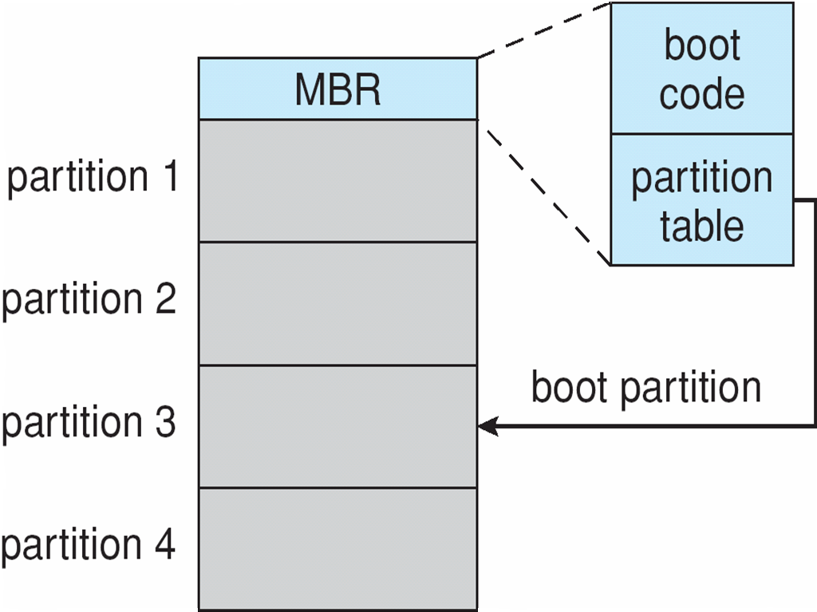
Device Storage Management (Cont.)
Raw disk access for apps that want to do their own block management, keep OS out of the way (databases for example).想要进行自己的块管理的应用程序的原始磁盘访问，让操作系统远离（例如数据库）。
Boot block initializes system.引导块初始化系统。
The bootstrap is stored in ROM, firmware.引导程序存储在 ROM、固件中。
Bootstrap loader program stored in boot blocks of boot partition.Bootstrap加载程序存储在引导分区的引导块中。
Methods such as sector sparing used to handle bad blocks.用于处理坏块的扇区备用等方法。
Booting from secondary storage in Windows.从 Windows中的辅助存储启动

Slide 31
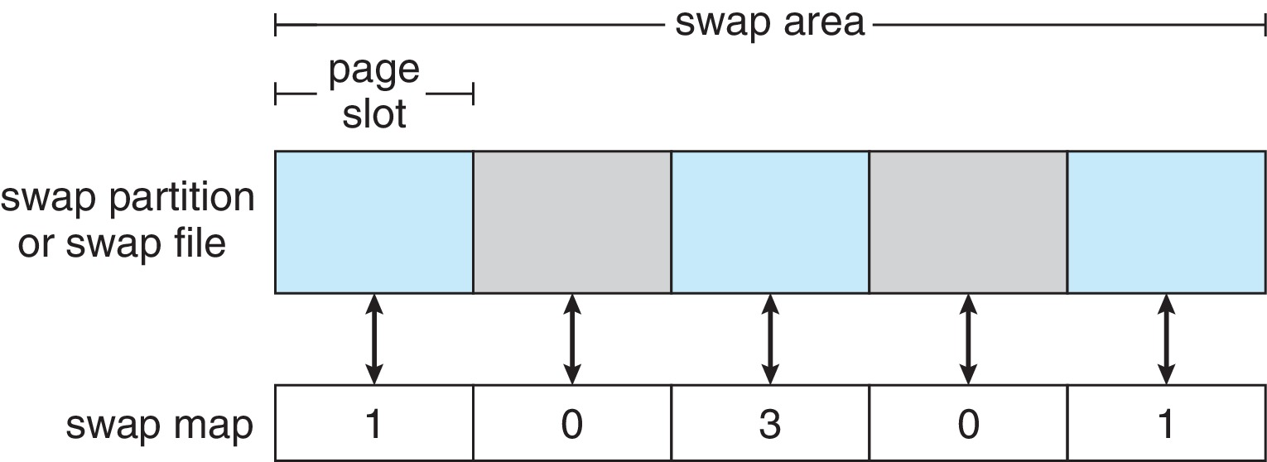
Swap-Space Management交换空间管理
Used for moving entire processes (swapping), or pages (paging), from DRAM to secondary storage when DRAM not large enough for all processes.当 DRAM不足以容纳所有进程时，用于将整个进程（交换）或页面（分页）从 DRAM移动到辅助存储。
Operating system provides swap space management.操作系统提供交换空间管理
Secondary storage slower than DRAM, so important to optimize performance.二级存储比DRAM慢，因此对优化性能很重要。
Usually multiple swap spaces possible – decreasing I/O load on any given device.通常可能有多个交换空间——减少任何给定设备上的I/O负载。
Best to have dedicated devices.最好有专用设备。
Can be in raw partition or a file within a file system (for convenience of adding).可以在原始分区或文件系统内的文件中（为了添加方便）。
Data structures for swapping on Linux systems:用于在 Linux 系统上交换的数据结构：

Slide 32
Storage Attachment存储附件
Computers access storage in three ways.计算机以三种方式访问存储
host-attached.主机连接
network-attached.网络附加
cloud
Host attached access through local I/O ports, using one of several technologies.主机连接通过本地I/O端口访问，使用多种技术之一。
To attach many devices, use storage busses such as USB, firewire, thunderbolt.要连接许多设备，请使用 USB、火线、雷电等存储总线。
High-end systems use fibre channel (FC).高端系统使用光纤通道 (FC)。
High-speed serial architecture using fibre or copper cables.使用光纤或铜缆的高速串行架构。
Multiple hosts and storage devices can connect to the FC fabric.多个主机和存储设备可以连接到FC结构。

Slide 33
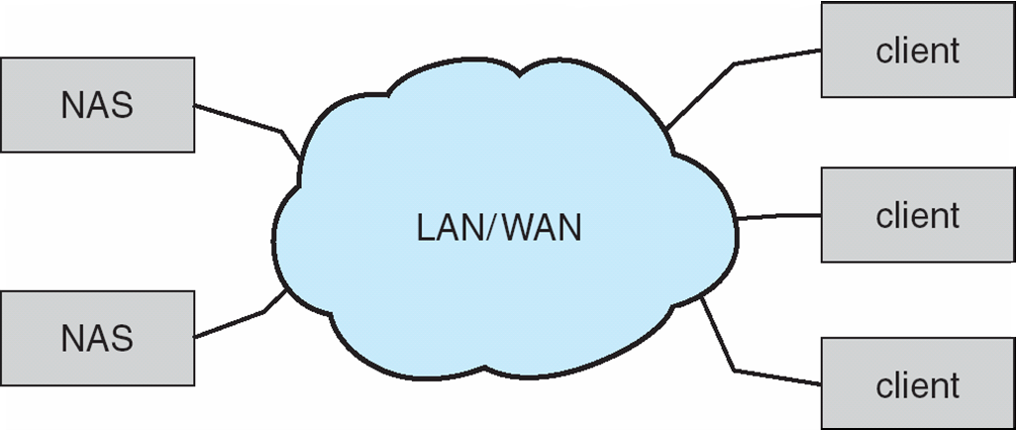
Network-Attached Storage网络附加存储
Network-attached storage (NAS) is storage made available over a network rather than over a local connection (such as a bus).网络附加存储 (NAS) 是通过网络而非本地连接（例如总线）提供的存储。
Remotely attaching to file systems.远程连接到文件系统。
NFS and CIFS are common protocols.NFS和CIFS是常见的协议。
Implemented via remote procedure calls (RPCs) between host and storage over typically TCP or UDP on IP network.通过主机和存储之间的远程过程调用 (RPC) 实现，通常通过IP网络上的TCP或UDP。
iSCSI protocol uses IP network to carry the SCSI protocol.iSCSI 协议使用IP 网络承载SCSI 协议。
Remotely attaching to devices (blocks).远程连接到设备（块）

Slide 34
Cloud Storage云储存
Similar to NAS, provides access to storage across a network.与NAS类似，提供对网络存储的访问
Unlike NAS, accessed over the Internet or a WAN to remote data center.与NAS不同，通过Internet或WAN访问远程数据中心。
NAS presented as just another file system, while cloud storage is API based, with programs using the APIs to provide access.NAS只是另一个文件系统，而云存储是基于API 的，程序使用API来提供访问。
Examples include Dropbox, Amazon S3, Microsoft OneDrive, Apple iCloud.示例包括 Dropbox、Amazon S3、Microsoft OneDrive、Apple iCloud。
Use APIs because of latency and failure scenarios (NAS protocols wouldn’t work well).由于延迟和故障情况而使用 API（NAS 协议不能很好地工作）。

Slide 35
Storage Array存储阵列
Can just attach disks, or arrays of disks.可以只附加磁盘或磁盘阵列
Avoids the NAS drawback of using network bandwidth.避免使用网络带宽的 NAS 缺点。
Storage Array has controller(s), provides features to attached host(s).存储阵列具有控制器，为连接的主机提供功能。
Ports to connect hosts to array.将主机连接到阵列的端口。
Memory, controlling software (sometimes NVRAM, etc).内存、控制软件（有时是 NVRAM 等）。
A few to thousands of disks.几个到数千个磁盘。
RAID, hot spares, hot swap (discussed later).RAID、热备件、热插拔（稍后讨论）。
Shared storage -> more efficiency.共享存储 -> 更高效率
Features found in some file systems.在某些文件系统中发现的功能
Snaphots, clones, thin provisioning, replication, deduplication, etc.快照、克隆、精简配置、复制、重复数据删除等

Slide 36
Storage Area Network存储区域网络
Common in large storage environments.常见于大型存储环境。
Multiple hosts attached to multiple storage arrays – flexible.多个主机连接到多个存储阵列 – 灵活。

Slide 37
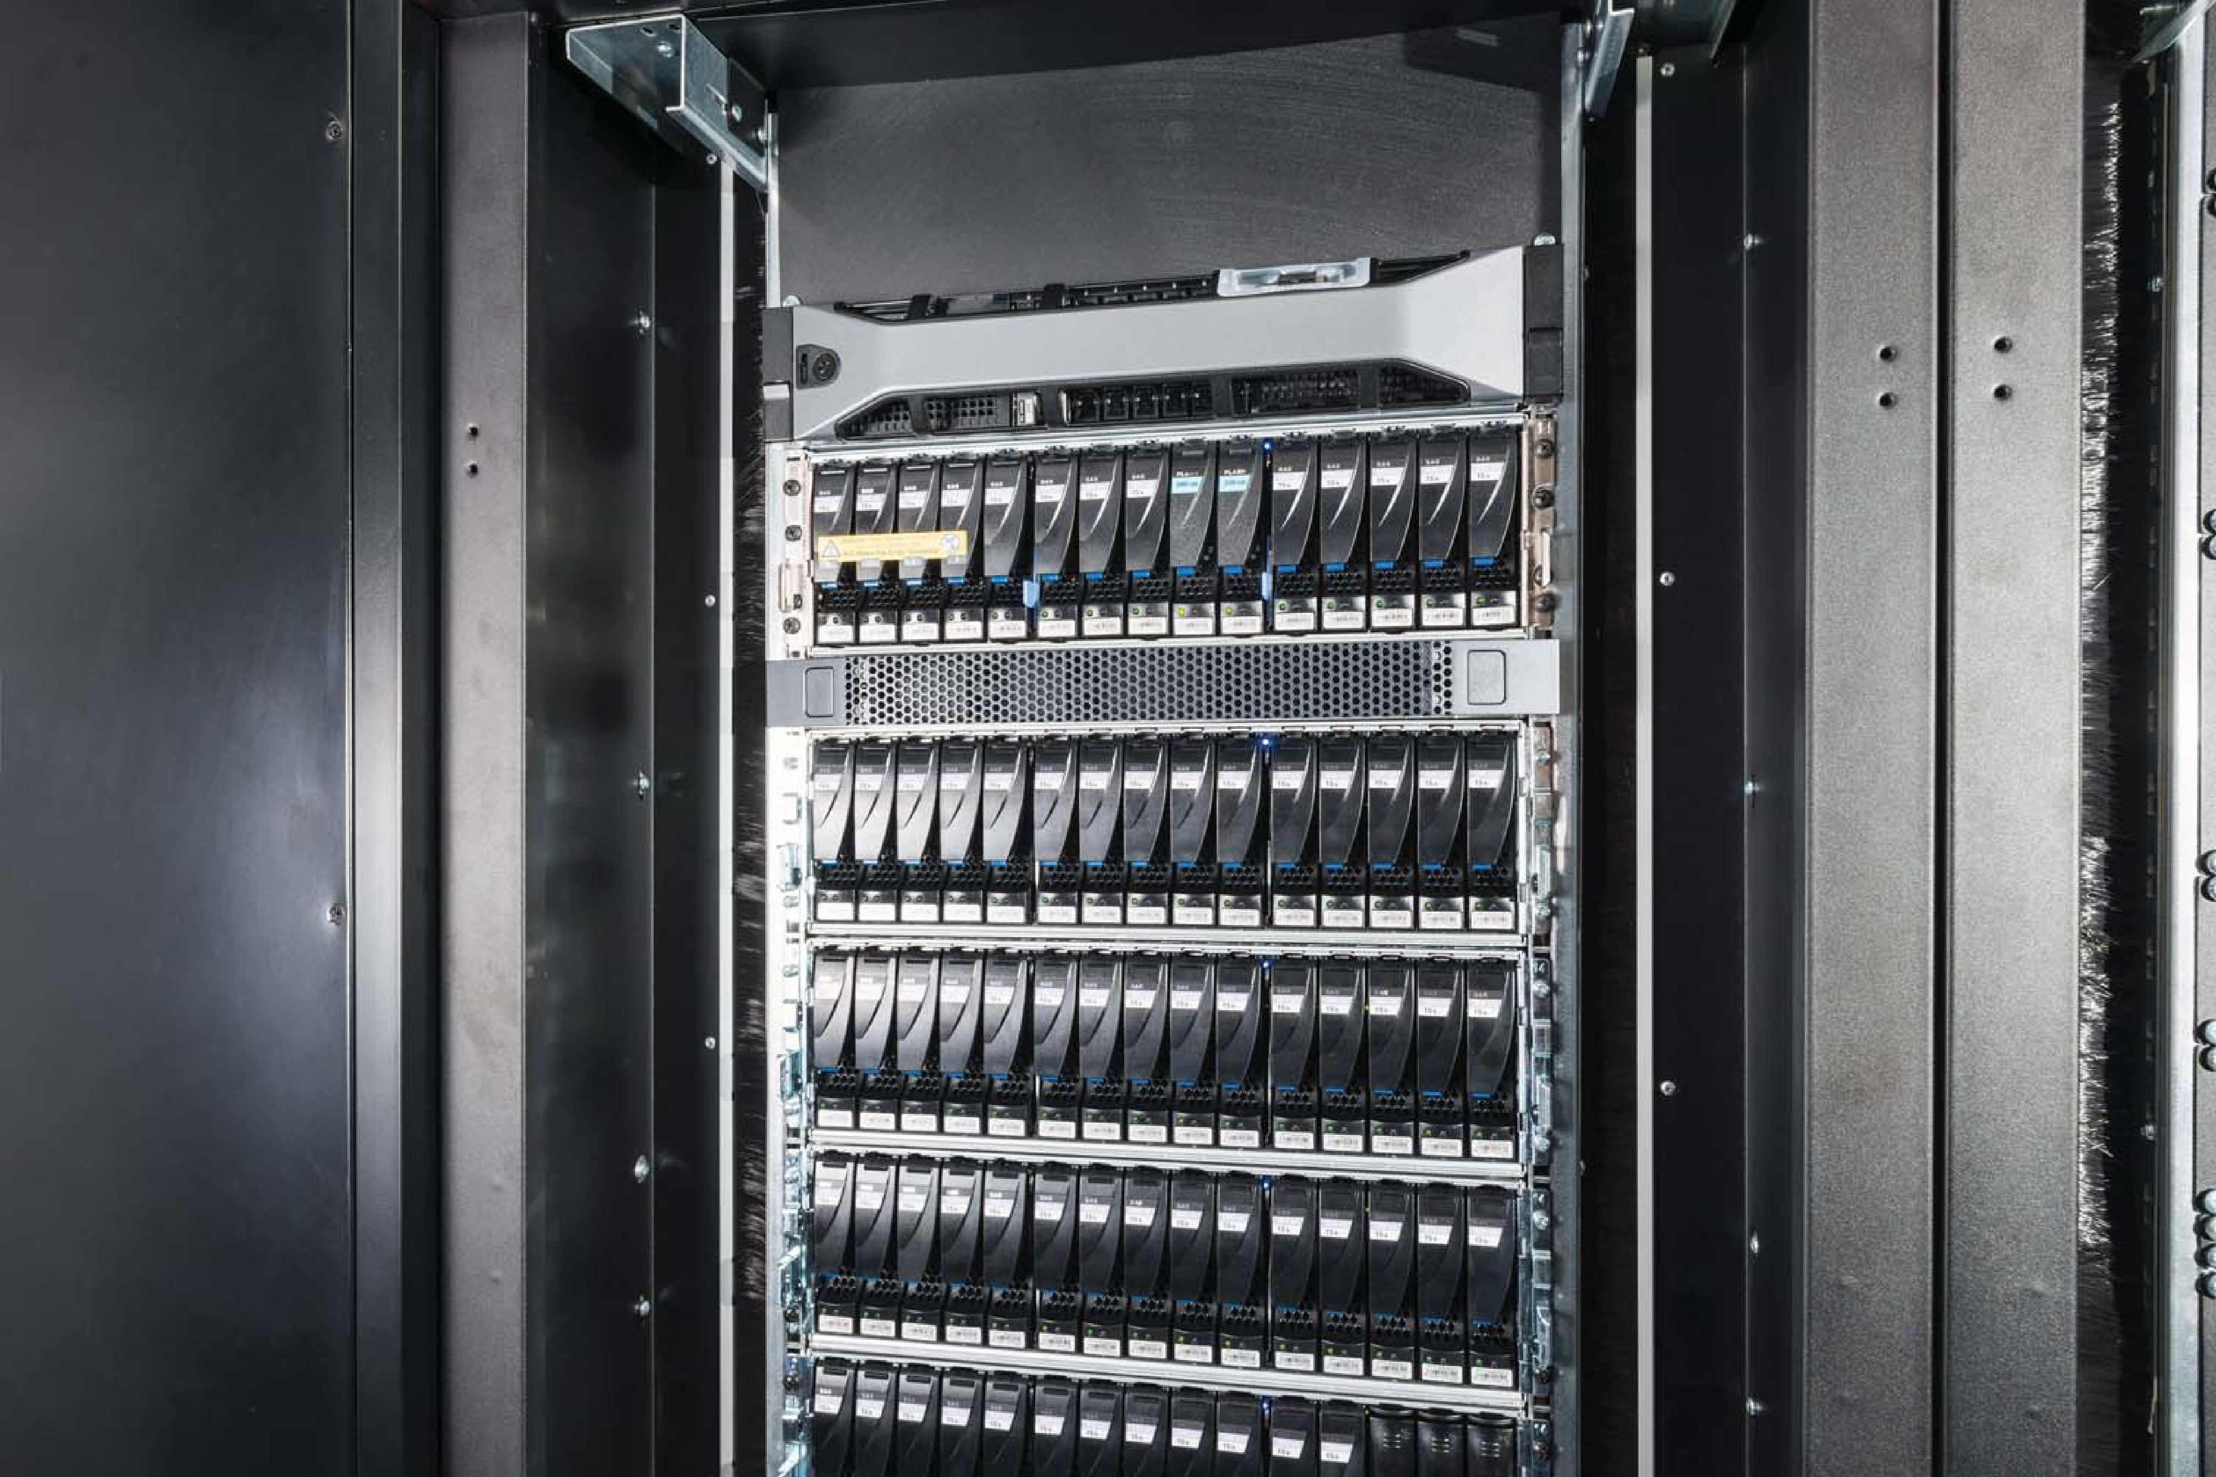
Storage Area Network (Cont.)
SAN is one or more storage arrays.SAN 是一个或多个存储阵列
Connected to one or more Fibre Channel switches or InfiniBand (IB) network.连接到一个或多个光纤通道交换机或 InfiniBand (IB) 网络.
Hosts also attach to the switches.主机也连接到交换机。
Storage made available via LUN Masking from specific arrays to specific servers.通过 LUN 掩码从特定阵列到特定服务器的存储可用。
Easy to add or remove storage, add new host and allocate it storage.易于添加或删除存储，添加新主机并为其分配存储。
Why have separate storage networks and communications networks?为什么要有独立的存储网络和通信网络？
Consider iSCSI, FCOE.考虑 iSCSI、FCOE
A Storage Array

Slide 38
RAID Structure
RAID – redundant array of inexpensive disks.RAID – 廉价磁盘的冗余阵列
multiple disk drives provides reliability via redundancy.多个磁盘驱动器通过冗余提供可靠性。
Increases the mean time to failure.增加平均失败时间。
Mean time to repair – exposure time when another failure could cause data loss.平均修复时间——当另一个故障可能导致数据丢失时的暴露时间。
Mean time to data loss based on above factors.基于上述因素的平均数据丢失时间。
If mirrored disks fail independently, consider disk with 1300,000 mean time to failure and 10 hour mean time to repair.如果镜像磁盘独立发生故障，请考虑平均故障时间为1300,000次且平均修复时间为 10 小时的磁盘。
Mean time to data loss is 100, 000² / (2 ∗ 10) = 500 ∗ 10⁶ hours, or 57,000 years!
Frequently combined with NVRAM to improve write performance.经常与 NVRAM 结合以提高写入性能。
Several improvements in disk-use techniques involve the use of multiple disks working cooperatively.磁盘使用技术的一些改进涉及使用多个协同工作的磁盘。

Slide 39
RAID (Cont.)
Disk striping uses a group of disks as one storage unit
RAID is arranged into six different levels
RAID schemes improve performance and improve the reliability of the storage system by storing redundant data
Mirroring or shadowing (RAID 1) keeps duplicate of each disk
Striped mirrors (RAID 1+0) or mirrored stripes (RAID 0+1) provides high performance and high reliability
Block interleaved parity (RAID 4, 5, 6) uses much less redundancy
RAID within a storage array can still fail if the array fails, so automatic replication of the data between arrays is common
Frequently, a small number of hot-spare disks are left unallocated, automatically replacing a failed disk and having data rebuilt onto them

Slide 40
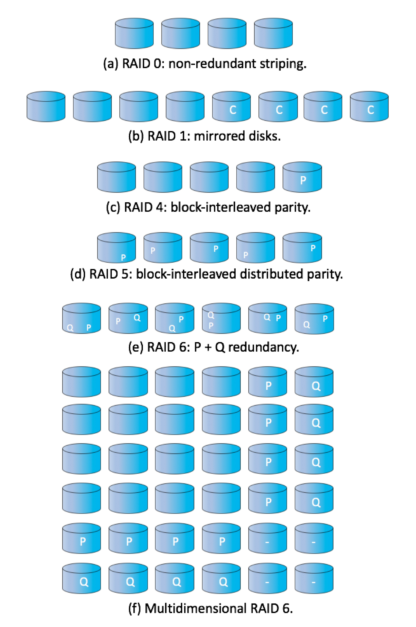
RAID Levels

Slide 41
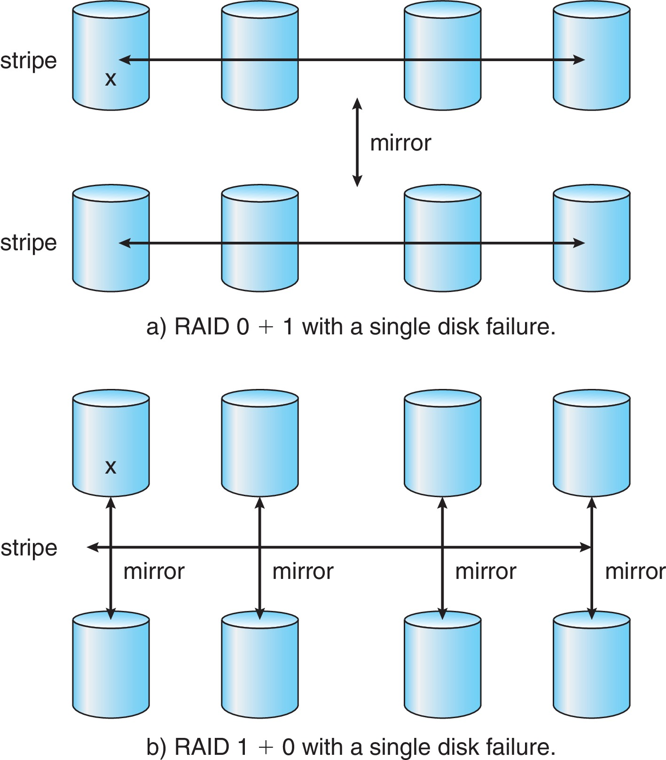
RAID (0 + 1) and (1 + 0)

Slide 42
Other Features
Regardless of where RAID implemented, other useful features can be added
Snapshot is a view of file system before a set of changes take place (i.e. at a point in time)
More in Ch 12
Replication is automatic duplication of writes between separate sites
For redundancy and disaster recovery
Can be synchronous or asynchronous
Hot spare disk is unused, automatically used by RAID production if a disk fails to replace the failed disk and rebuild the RAID set if possible
Decreases mean time to repair

Slide 43
Extensions
RAID alone does not prevent or detect data corruption or other errors, just disk failures
Solaris ZFS adds checksums of all data and metadata
Checksums kept with pointer to object, to detect if object is the right one and whether it changed
Can detect and correct data and metadata corruption
ZFS also removes volumes, partitions
Disks allocated in pools
Filesystems with a pool share that pool, use and release space like malloc() and free() memory allocate / release calls
ZFS checksums all metadata and data

Slide 44
Traditional and Pooled Storage

Slide 45
Object Storage
General-purpose computing, file systems not sufficient for very large scale
Another approach – start with a storage pool and place objects in it
Object just a container of data
No way to navigate the pool to find objects (no directory structures, few services
Computer-oriented, not user-oriented
Typical sequence
Create an object within the pool, receive an object ID
Access object via that ID
Delete object via that ID

Slide 46
Object Storage (Cont.)
Object storage management software like Hadoop file system (HDFS) and Ceph determine where to store objects, manages protection
Typically by storing N copies, across N systems, in the object storage cluster
Horizontally scalable
Content addressable, unstructured

Slide 47
End of Chapter 11

